Slide 1
Smart Dust
Exploring the capabilities and uses of Smart Dust in Survelliance

Slide 2
Understanding Smart Dusts
Micro-electromechanical sensors (MEMS) are designed to be tiny (as small grains of dust) and capable of wirelessly collecting, processing, and transmitting data.
Smart Dust is measured at one cubic millimetre or less.
These sensors measure temperature, light, sound, air pressure and humidity stimuli. They also detect movements and can be used for tracking purposes.
Initially conceptualized for environment monitoring, but sponsored by the US Military for battlefield surveillance. Market value estimated to be about 392 million dollars by 2032.
Proposed by Dr. Kris Pister at University of California, Berkeley.

Slide 3
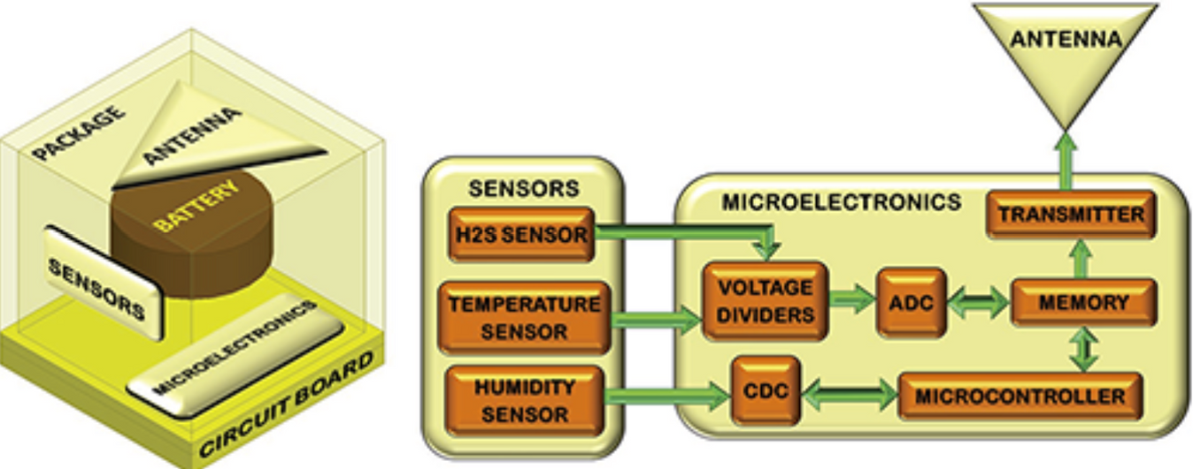
Understanding Smart Dusts
Based on common IOT devices, extract key information and relay it to a central server for processing.
Individual grain is called a “Mote.” Each mote can detect external stimuli in real-time.
Each Mote is built with circuitry for sensing and computing capabilities.

Slide 4
Understanding Smart Dusts
Motes communicate with one another with radio frequency transceivers and independently transmit data to a central server wirelessly.
Motes rely on an in-built power supply. Some use energy harvesting technologies like photovoltaic solar cells, thermal capture or ambient vibrations. Each mote battery life could last up to 10 years.
They are encapsulated in protective ploymer-based materials to shield from harsh conditions. The constructed with silicon microfabrication tecniques and can reamin susoended in the air.

Slide 5
How Smart Dust Operates in Surveillance
Dust motes are spread across target areas to start data collection on movement, temperature, and other parameters.
Motes automatically link with nearby motes, forming a resilient mesh network to relay data.
Each mote processes and compresses data before transmission, saving energy and reducing load.
Data is sent to a central hub for instant analysis, enabling rapid response.

Slide 6
Applications in Survellience
Enables discreet monitoring of troop and enemy movements.
Identifies toxic gases and hazardous materials for safety alerts for troops on the battlefield.
Used for suvelliance in Smart Cities.

Slide 7
Conclusion
Small but mighty: MEMS sensors that collect and transmit data, despite being only millimeters in size.
Self-Sustaining: With self-organizing networks and energy-efficient power sources, smart dust can function autonomously in challenging environments.
Surveillance: Its application in military and urban surveillance enables monitoring and rapid response to threats.
.

Slide 8
References
https://builtin.com/articles/smart-dust
https://people.eecs.berkeley.edu/~pister/SmartDust/SmartDustBAA97-43-Abstract.pdf
https://www.nanowerk.com/smart/smart-cities-explained.php
https://www.linkedin.com/pulse/we-all-breathing-smart-dust-institute-of-innovation-and-knowle/
https://www.forbes.com/sites/bernardmarr/2018/09/16/smart-dust-is-coming-are-you-ready/
.

